Slide 1

Presentation title: SMTPS (Simple Mail Transfer Protocol Secure)
Course Title: Computer Networks
Course Code: ICT-3201
Presented by | Supervised by
Tasnim Zannat Naima ID: IT-22001 Session: 2021-22 Dept of ICT,MBSTU | Dr. Nazrul Islam Associate Professor Dept. of ICT, MBSTU

Slide 2
Contents
Introduction
SMTP
Why SMTPS
Working Principle
Key Features
SMTPS vs SMTP
SMTPS Communication Process
Advantages and Limitations
Real-World Example
Conclusion

Slide 3
Introduction
• SMTPS stands for Simple Mail Transfer Protocol Secure.
• It is the secure version of SMTP that uses SSL/TLS encryption.
• Ensures that email data transmitted between mail servers is encrypted.
• Introduced to enhance privacy and prevent eavesdropping.

Slide 4
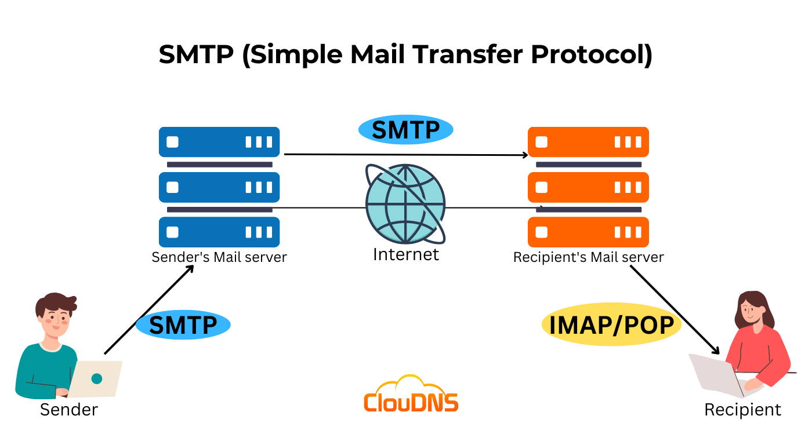

Slide 5
SMTP
SMTP (Simple Mail Transfer Protocol) is used for sending emails between servers.
It operates on port 25 (default).
SMTP itself is not encrypted, meaning emails can be intercepted.

Slide 6
Why SMTPS?
SMTP alone is insecure.
SMTPS ensures data privacy and integrity.
Prevents eavesdropping, spoofing, and tampering during email transfer.

Slide 7
Working Principle
SMTPS works on the same principles as SMTP but adds a security layer using SSL/TLS.
Client connects to mail server using SSL/TLS.
Server sends a digital certificate to authenticate itself.
Encrypted channel is established.
Email is transmitted securely using SMTP commands.

Slide 8
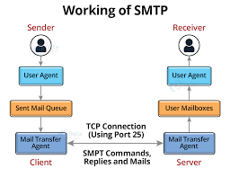

Slide 9
Key Features
• Provides authentication and encryption.
• Prevents interception of emails by third parties.
• Supports both implicit and explicit TLS.
• Ensures integrity and confidentiality of messages.

Slide 10
SMTPS vs SMTP
Feature | SMTP | SMTPS
Encryption | No | Yes (SSL/TLS)
Default Port | 25 | 465 / 587
Security | Low | High
Usage | Outdated | Modern standard

Slide 11
SMTPS Communication Process
Mail client initiates a connection.
Server responds with its certificate.
Client verifies certificate authenticity.
Encrypted communication begins.
Emails are transmitted securely.

Slide 12
Advantages and Limitations
Advantages:
• Secure and reliable email delivery.
• Protects data from attackers.
• Easy integration with existing mail systems.
Limitations:
• Requires SSL certificates.
• Slightly higher server overhead.
• Dependent on client-side support for TLS.

Slide 13
Real-World Example
Gmail, Yahoo Mail, and Outlook use SMTPS for secure email transmission.
Example configuration:
Server: smtp.gmail.com
Port: 465 (SSL) or 587 (TLS)
Authentication: Required

Slide 14
Conclusion
SMTPS ensures secure, encrypted email transmission.
It’s an essential standard for modern email communication.
SMTP + TLS = SMTPS → Safe Email Exchange

Slide 15
Thank You

